Slide 1
ST(SI)²

Slide 2
Next Generation Networks PMR
Status in France
----
Possible way forward towards a global standard
Emmanuelle Villebrun, French Ministry of Interior
3GPP-ETSI-OMA workshop
Montreal, 26-27 August 2014

Slide 3
Critical Communications Infrastructures in France
Public Safety : 2 national TETRAPOL networks for voice communications and low speed data
Infrastructure Nationale Partageable des Transmissions (INPT)
  • Mainly police, fire brigades + other users
  • 400MHz ~1500 sites for national coverage
  • TDM backbone
RUBIS
  • Gendarmerie, Marine nationale
  • 80MHz ~500 sites + 400MHz extensions
  • IP backbone
Critical Business communications
  TETRA networks by SNCF, RATP, Aéroports de Paris, polices municipales
→ Develop common infrastructure for the future for as many users as we can

Slide 4
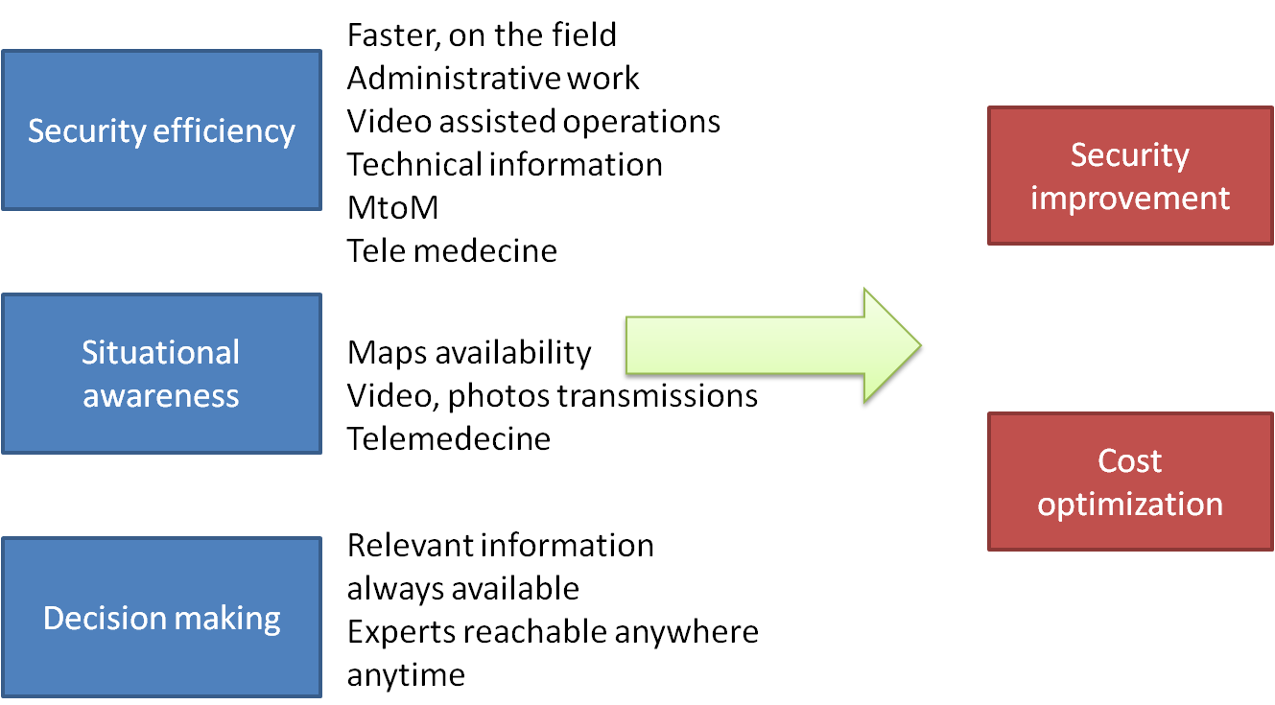
New services to improve security and its efficiency

Slide 5
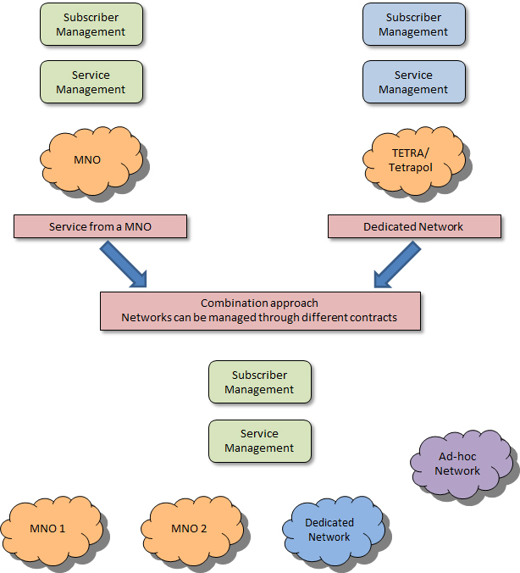
General strategy
Separate:
  Data transport
  Service management
  Subscriber management
One contract split
In three or more
Not to forget : Proximity Services, Isolated/fall back modes, resiliency

Slide 6
Consequences on infrastructure (about IMS…)
We need te be able not to rely on commercial infrastructure
  Some users will always need their own infrastraucture
    Public safety, militaries, critical utilities
  Some will need to ensure a minimum of independance with self deployable networks
    In case of catastrophy or big event
    When life is at stake (public will not accept rescue being late because of telecommunication failure)
Private and public networks will be used in parallel like today
Commercial technology reuse
  Only what we need (not all commercial services 3GPP could imagine!)
  Being able to have a dedicated independant infrastrucure
  Infrastructure of different size without all commercial functions
    Control room in a truck, mobile control room (not full IMS!!!)
  With full interoperability with commercial networks for critical communications services!

Slide 7
Need for a standard as global as possible
New focus on critical communications specific questions
  Professionnal services (group communications, video communications)
  Open interfaces to ensure the ability of any organization to develop professionnal softwares (Interfaces with control rooms)
  Priority management between different organizations depending multiple factors including the event type
New opportunities for companies to adress just a part of the market
  with an open environment
  with any useful technology (Machine to Machine, professionnal dedicated softwares etc…)
Innovation and competition are essential for the next generation public safety telecommunication infrastructures, users have to organize the market through standards development

Slide 8
Key functions needed
Transport functions
  PROSE, IOPS, GCSE
Application functions
  MINIMUM FIRST SET OF SERVICES: Group communications for any kind of data (text, video, files) in order to instantaneously share data between people on the field
  Applications for information management (datamining, video/sensor information management)
    In the control room
    In the future could be done on the field also (small control rooms unit in a truck)
Cost management needs
  Avoid to manage multiple networks → that is why we also need voice….
With no data application, users have no reason to buy a LTE network since classical data applications are too limited

Slide 9

Standardization on going works
Standards different streams
  OMA and ETSI for application part
  3GPP for transport and voice MCPTT
ETSI standard is at « stage 2 » with a defined architecture
  Generic group communication able to manage any kind of data
  User requirements light procedure
OMA standard for Public Safety begins with user requirements
  Will be aligned with release 13, other functions such as location management
Push OMA and ETSI to liaise with each other → 9 month to organize a conference call (seems there was some resistance!)…
3GPP → Voice only in release 13
  User requirements entirely redone for voice without data enhancement
No one meets our needs…

Slide 10
Work item synchronization
3GPP MCPTT
ETSI TCCE
PROSE
GCSE
Already existing IMS interfaces
+ new functions
User Id @SIP
Organization management
Group management
Profile management
Application priority management
IMSI
RAN resources for users
Radio bearer
Wired transport in RAN
MBMS
Priority management (global parameters)
Access control
Radio bearer priority and preemption
Control if private network
Generic MCPTT
Dispatcher data management
Operationnal event logging
Video surveillance
Data mining
Remote sensor operations
Distant operations (medical, rescue, expertise)
Negociation if public or
shared network

Slide 11
Road map for application part
3GPP R 13
3GPP R 14
Requirements
Architecture
Protocols
Requirements
ETSI
TETRA/TETRAPOL/P25 protocols
Enhancements for data
Other services
3GPP
Video
Voice without use cases
SMS
Maps…
Detailed use cases for any kind of data???

Slide 12
Way forward
Time management: PMR standards were developped over 20 years
  Conclusion in ETSI : redoing all would take to much time
  What 3GPP will do? We have completely redone requirements, do the same for technical work?
User organizations are able to buy their own proprietary solution
  Like in TETRA and TETRAPOL they will buy the solution before interoperability testing
  Interoperability will then be expensive or impossible
We need a first version standard as quick as possible
  With new data services to avoid proprietary solutions
  With voice in order to avoid maintaining several networks
A world wide standard is really suitable but…
A regional/local such as ETSI remains a fallback solution if world wide is not possible
  Manage operational constraints at borders with big political impact

Slide 13
Proposed way forward (may be last chance for a global standard!)
There is a remaining way forward
  Take ETSI work as a basis
  Generic Group communication taken into account as soon as the architecture work on application part begins
    Requirements shall be put in early release 14
    Release 13 that takes into account generic group communication in advance
  Start the work on other applications in SA1 → priority management issue between Critical Communications and commercial world
But… way of working has to be really improved!
  Being generic, managing all kind of data at the same time
  Work items synchronization
  Create a new dedicated group to avoid bottlenecks and to be able to go faster
  Avoid time consuming liaisons between different groups in 3GPP
  → ability to have one or more subgroups (one for security at application level, discussion forum for user requirements,…)

