Slide 1
MCPTT Standards
Tom Hengeveld
Senior Scientist, Harris PS&PC

Slide 2


Harris Corporation At-A-Glance
Mission Critical Communications For Commercial & Government Markets Worldwide
Leader in design, development and operation of highly-reliable, secure communications systems and information networks for voice, data, video, and imaging
    $5+ Billion U.S. company based in Melbourne, Florida
      Publicly listed on NYSE (ticker: HRS)
      14,000 employees located in 50+ countries around the world (6,000 engineers/scientists)

Slide 3
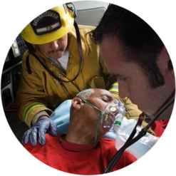

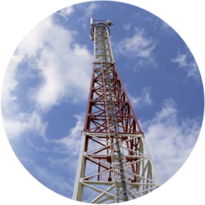
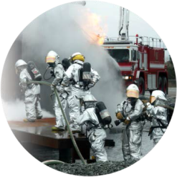

Public Safety Experience
80+ years of leadership in Public Safety communications
More than 600 network deployments worldwide
Over a decade of experience deploying IP-Based Communications Solutions for First Responders
Standards Participation
  TIA (TR8), 3GPP, ATIS, OMA
Public Safety Forums
  NPSTC, PSCR, APCO, APIC

Slide 4
MCPTT Standards Development
Harris wants a bona fide and relevant standard for MCPTT
  Bona fide: Endorsed by FirstNet and other global public safety institutions (UKHO, French MOI, etc.) and manufacturers are committed to its development.
  Relevant: Truly satisfies first responder needs; likely to be adopted by PS agencies for mission critical use.
MCPTT Standard
  3GPP Enabled (e.g., GCSE) and Endorsed
  Open to leveraging applicable work from other SDOs if it facilitates the creation of a globally accepted standard
    OMA, ETSI, TIA, ATIS
  Should be forward looking, but
    Must not require instantaneous adaptation of new roles and operating procedures, therefore,
    Should leverage Public Safety’s LMR experience
  Should encourage operational innovation by public safety practitioners, but should not force adaptation of new paradigms that are not grounded in operational needs
  Must facilitate migration from legacy narrowband technologies (esp. P25,Tetra)

Slide 5
Critical Aspects of the Standard
Public Safety Feature Set
  Public Safety Grade Performance and Reliability
  Support current operating paradigms with analogous features
  Exploit innovative capabilities provided by conjoined communications
  Maintain first responder “heads up” awareness while enhancing safety, information access, and cooperation
The tool is not the mission.
Security & Privacy
  Secure from intrusion, denial of service, and unauthorized eavesdropping while satisfying local laws related to public access to public safety operations
  End-to-end confidentiality even with legacy interworking
  Available privacy vis-à-vis other authorized users including operators, other agencies

Slide 6
Critical Aspects of the Standard
Support public safety’s need for adaptable response by providing
  Local Control of mission affecting configurations (e.g., control of communications nets (who can talk to whom), operating modes, communications priority)
  Real-time Local Visibility into service status, KPIs, loading etc.
  Both on-network and off-network deployment topologies
Forward Facing Architecture considers:
  Current technologies
    Cloud computing, software as a service
  Emerging technologies
    Software defined networking, network function virtualization, etc.,

Slide 7
Harris is committed to a global broadband MCPTT standard and will actively contribute our domain knowledge and technical experience in public safety communications to help bring it to fruition.

Slide 8
Thank-you

