Slide 1
Hub One Experiment
August 2014

Slide 2
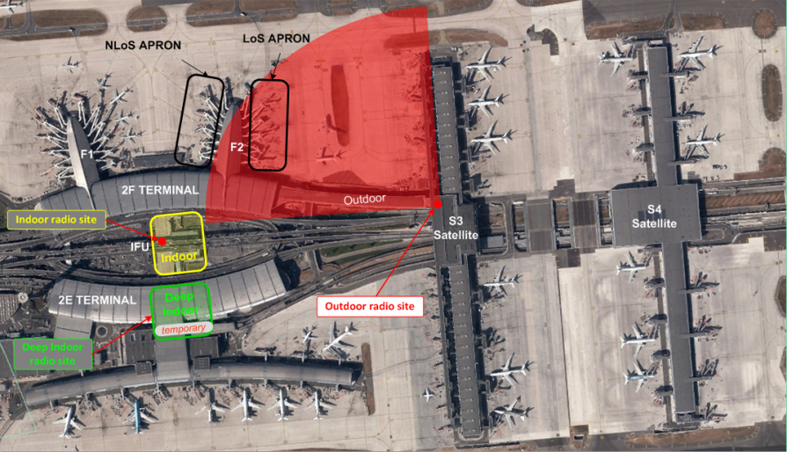
An experiment at Roissy Charles de Gaulle Airport
December 2013 to April 2014
Three test environments
Indoor, Deep indoor, Outdoor
2 frequency bands
400MHz, 700MHz
Large impact
300 visitors, events, press releases

Slide 3
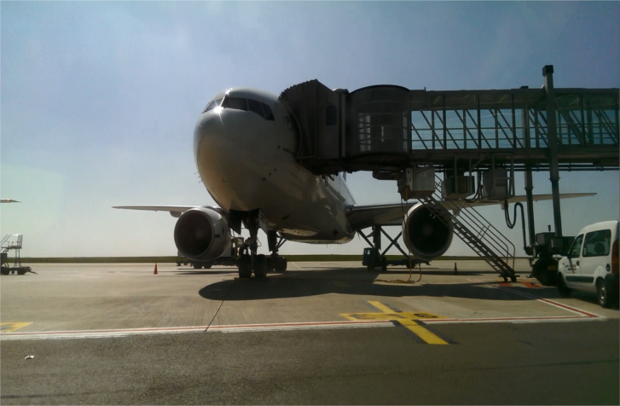
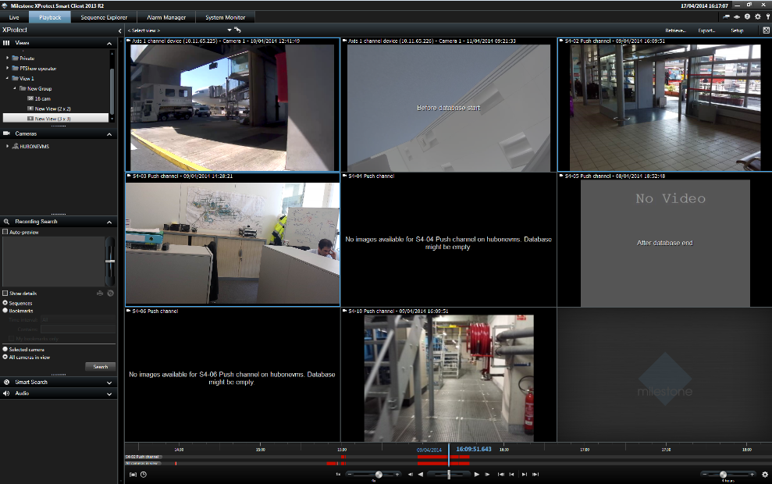
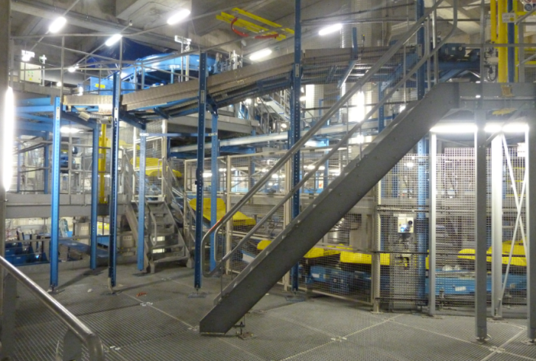
Critical / professionnal LTE communications in a large airport
+ 500 technical radio tests
+ 100 airport applications test scenarios
Non standard LTE PMR solution
Airport security applications (Capricorn)
Ground to planes data transmission (parking)
New use cases evaluation (data and video group communications, video surveillance)
THROUGHPUTS
@ 10MHz FDD
17 MBPS UPLINK
60 MBPS DOWNLINK

